Slide 1
Software Development Standard Operating Procedures

Slide 2
Why?
CLIA, New York State, and CAP QMS guidelines essentially require any activity that touches a patient sample to be covered by SOPs
This includes developing and operating software

Slide 3
Advantages
Documentation trail for audits
Transparency and Traceability
Vetting
Separation between developers + testers
Additional level of testing beyond unit and integration testing
Meets the guidelines of the regulatory bodies to which we must adhere

Slide 4
How were the standards in Branford developed?
A combination of Medical Diagnostics industry best practices (CLSI) and elements of Software Development methodology (ie agile)
Originally focused on LIMS development, but expanded to all software that touches patient samples
Reference: Clinical Laboratory Standards Institute (2006); AUTO08-A: Managing and Validating Laboratory Information Systems

Slide 5
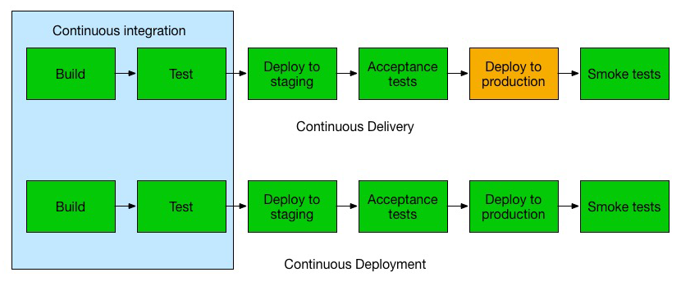



How were the standards in Branford developed?
Not all elements of modern software development can be included

Slide 6
Branford Policies and SOPs
Overarching policy in Branford is SEMA4-CT-QA-POL-0017 Validation, Development, and Implementation of Computer Systems
Covers from software planning to post Go-live
Bioinformatics and LIMS have developed separate SOPs that refer to this SOP

Slide 7

POL-0017: Planning
Do we need outside vendors?
Is training required for staff/vendors?
Develop requirements
User Requirements Specification (URS) or Software Requirements Specification (SRS)
Can be done in conjunction with “user stories”
Continuously updated as development proceeds
Develop Validation Project Plan – which track (IQ/OQ/PQ or V&V)?

Slide 8
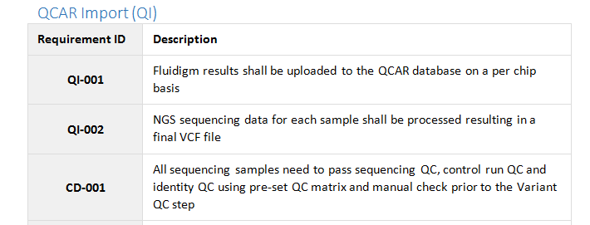
POL-0017: Planning
Requirements example (can match feature requests in JIRA)
Can include diagrams
Used in the requirements traceability matrix

Slide 9
POL-0017: Planning
IQ,OQ,PQ Track | V&V Track
Vendor supplied hardware or software | In-house developed software on generic hardware only

Slide 10
Brief overview of IQ,OQ,PQ track
IQ (Installation Qualification)
Set of Test Cases that tests the system is installed properly and that peripherals and dependencies connect to the system
LIMS Administrator executes the tests and documents results
OQ (Operational Qualification)
Set of Test Cases which cover testing of all Functional Requirements
Documented evidence that the system functions according to the system Functional Requirements Specifications (FRS)
LIMS Administrator executes the tests and documents results
PQ (Performance Qualification)
Set of Test Cases which cover testing of all User Requirements
Documented evidence that all modifications to the system function according to the system User Requirements Specifications (URS)
Subject Matter Experts (SMEs) execute the tests and document results

Slide 11
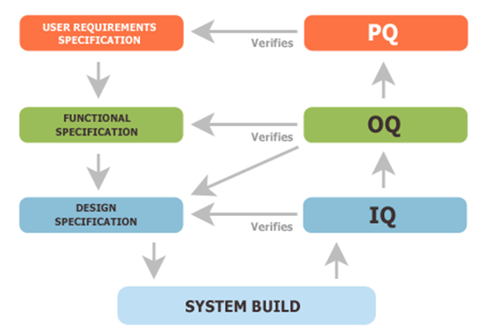
Brief overview of IQ,OQ,PQ track

Slide 12
Brief overview of IQ,OQ,PQ track
Deliverables
Validation Project Plan (Draft Provided by vendor)
Installation Guide (Provided by vendor)
Technical Requirement Specification (Template)
IQ Protocol (Test Scripts Provided by vendor)
Functional Requirements Specifications (Provided by vendor)
OQ Protocol (Test Scripts Provided by vendor)
User Requirement Specifications (Developed with Customer)
PQ Protocol (Test Scripts not Provided)
Validation Summary Report (Template)

Slide 13
V&V Track – Hardware Installation and Risk assessment
Generally IT team requisitions appropriate hardware
Recommended to follow the Dev/Test/Prod paradigm
Perform risk assessment post-installation
Technical Requirements Specification (TRS) Documents the system configurations for Dev/Test/Prod

Slide 14
V&V Track – V&V scripts
A set of test cases (test scripts) that document that the system performs as expected
Elements
Test Cases – a set of scripts written to test each requirement
Traceability Matrix – a table mapping each requirement from the URS or SRS to at least one test case
Should include multiple test types
Normal (ideal/happy path)
Invalid data
Edge cases
Regression tests

Slide 15
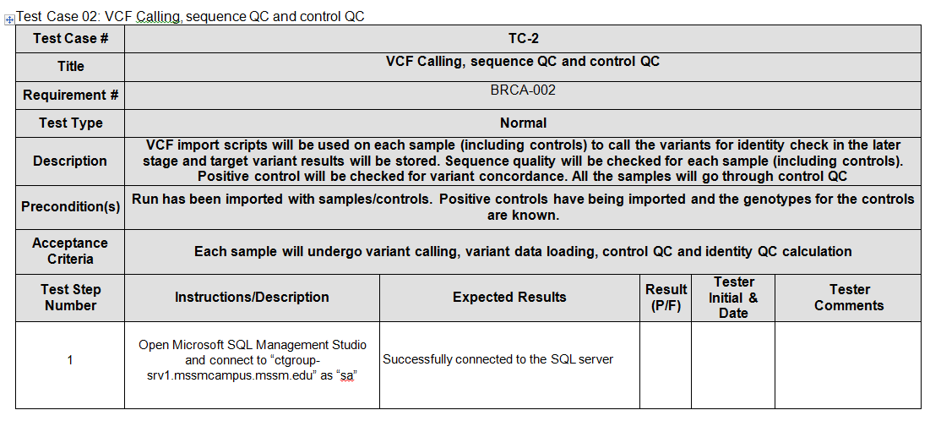
V&V Track – V&V scripts
Example of a test case

Slide 16
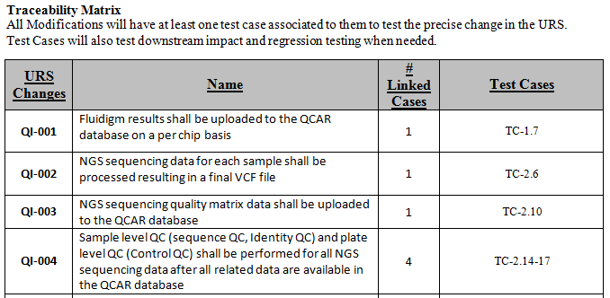
V&V Track – V&V scripts
Example of a traceability matrix
Ensure adequate testing coverage and used by auditors

Slide 17
V&V Track – V&V scripts
Validation Testing Error Report and Resolution Form
SEMA4-CT-QA-FORM-0048
Any errors that occur during V&V script testing should be documented using a form that describes the error, investigation, and proposed resolution

Slide 18
V&V Track – Validation Summary Report
Document that summarizes and confirms fulfillment of all validation activities
Includes any validation testing error report forms produced during V&V script testing

Slide 19
V&V Track – Deliverable Summary
Validation Project Plan
User/Software Requirement Specification
Technical Requirements Specification
V&V scripts
Validation Summary
Hard copies of all forms kept in binder with project lead
4 signatories for most deliverables
Clinical director
Business owner
Quality Assurance
Project Lead

Slide 20
SOPs and Training
Standard operating procedures and training scripts should be drafted for the software – ideally during development so they are ready following validation
Training scripts can copy V&V scripts

Slide 21
Important Forms post-Go Live
Non-conformity form (MSGTL-CT-QA-FORM-0011)
Form for documenting any system behaviors that do not match prescribed behavior in the SOP documentation
Change request form (ex. MSGTL-CT-BI-FORM-0001 or SEMA4-CT-BI-FORM-0003)
Form for documenting any change requests, potential risks and impacts, and obtaining approval
Requests can match JIRA tickets

Slide 22
Emergency Fixes post-Go Live
Risk Priority | Definition
High | The issue poses a significant risk to patient reporting outcomes
Medium | The issue poses a low risk to patient reporting outcomes
Low | There is no risk to patient reporting outcomes (ie cosmetic)
If the assessed risk priority is high, the change request will be “fast-tracked” meaning the validation will only consist of a set of PQ or V&V test scripts that cover changes made and any regression testing

